Slide 1
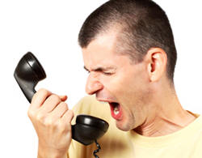







227 West 109 Street
Shalom Joseph

Slide 2
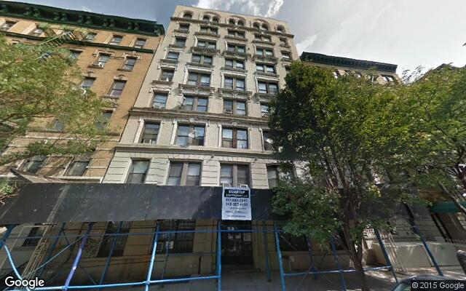
What’s going on here?
Built in 1912
Renovated in 1935
36 units
This building is a hotspot for several 311 requests.
History of complaints and structural damage.

Slide 3
Lets look at the data
From May of 2012 - June 2012, heating complaints spiked tremendously.
At the same time there were several complaints against the janitor and the super.
What can we conclude from this?
This could indicate a change in management due to existing problems that were never fixed.
It is also very uncommon for there to be heater problems in the summer.
In June of 2012 there weren’t any complaints against the Janitor or Super.
This can mean that the existing “problem”, whether it was an individual or an object in the building, had been resolved swiftly.

Slide 4
Yes there’s more!
In the same year there were complaints of General Construction, Paint and Plumbing.
Specifically in November and December.
Construction included the tiles. floor and molding.
Paint included the ceiling and walls.
Plumbing included water leaks and basin/sink.
What can be concluded?
All these problems derive off the other.
Problems in construction and paint can lead to plumbing problems and any other combination of the three.
This shows that this building has been through rough changes and that it was, at a point, very unstable.

Slide 5
Conclusion
http://apartable.com/buildings/227-west-109-street-manhattan#building-issues
This link provides all the information about this building and its specifics.
By the end of this year there will be around 280 issues reported to this link alone.
These issues include violations and complaints.

